Slide 1
DUBAI HOUSE PRICE

Slide 2
Contents
Executive Summary
Objective
Dataset Overview
Problem Statement
Data Preparation & Cleaning
Data Model & Calculated Fields
Key Performance Indicators (KPIs)
Dashboard Visualizations
Interactivity Features
Insights & Findings
Business Recommendations
Conclusion

Slide 3
Executive Summary
This project delivers a comprehensive real estate analytics dashboard designed to support strategic decision-making in Dubai’s property market.
The dashboard provides:
Market pricing trends
Location-based performance
Property demand analysis
Developer performance insights
It enables stakeholders to make data-backed investment decisions

Slide 4
Objective
The main objectives of this project are:
To analyze property price distribution across different locations.
To identify high-demand property types and bedroom configurations.
To evaluate price per square foot for better investment decisions.
To study developer performance and market share.
To build an interactive dashboard for data-driven decision-making.

Slide 5
Problem Statement
The Dubai real estate market is vast and dynamic, with thousands of property listings across different locations, property types, and price ranges.
However:
Investors struggle to identify profitable locations.
Buyers find it difficult to compare property values.
Agents lack a clear view of demand trends.
Raw data alone does not provide meaningful insights.
There is a need for an interactive and analytical dashboard that transforms raw housing data into clear, actionable insights for better decision-making

Slide 6
Dataset Overview
The dataset consists of Dubai housing property listings.
Key Attributes:
Price – Selling price (AED)
Bedrooms – Number of bedrooms
Bathrooms – Number of bathrooms
Size (Sqft) – Total property area
Property Type – Apartment, Villa, Townhouse
Year Built – Construction year
The dataset contains thousands of property records used for analysis.

Slide 7
Data Preparation & Cleaning
Steps Performed:
Removed duplicate records
Handled missing values
Corrected inconsistent text formats
Converted price and size columns to numeric format
Verified data accuracy
Calculated Fields Created:
Price per Sqft = Price ÷ Size
Property Age = 2025 – Year Built
Listing Category = Budget / Mid-Range / High-End.

Slide 8
Key Performance Indicators (KPIs)
Total Listings
Average Price
Average Size (Sqft)
Highest Priced Property
Average Price per Sqft
These KPIs provide a quick summary of the real estate market.

Slide 9
Dashboard Visualizations
The dashboard includes:
Bar Chart – Price by property type
Stacked Column Chart – Listings by bedrooms
Line Chart – Price trend over time
Pie Chart-Listing Category
Donet Chart- Property Age
Each visualization helps in understanding market trends clearly.

Slide 10
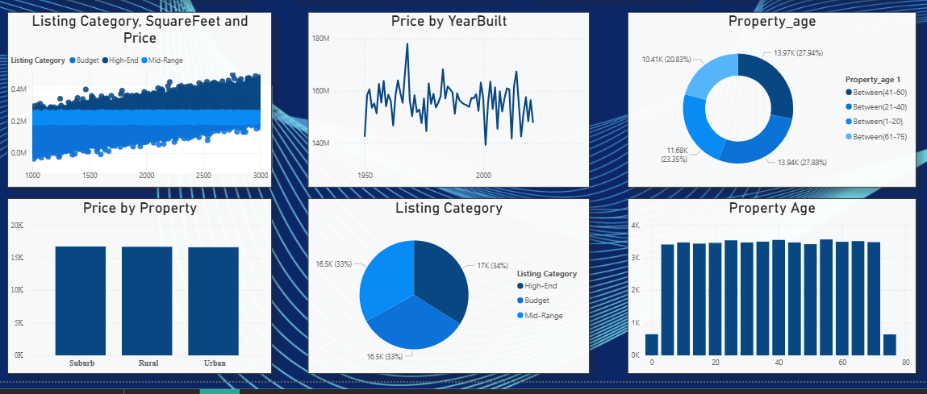
output

Slide 11

Interactivity Features
To improve user experience, interactive elements were added:
Slicers (Bedrooms, Property Type, Location, Price Range)
Dynamic filtering
Drill-through for detailed property view
Tooltips showing price per sqft
These features allow users to explore the data easily.

Slide 12
Insights & Findings
Key findings from the analysis:
Premium locations have higher average prices.
Apartments dominate the market in total listings.
Mid-range properties show stable demand.
Price per sqft varies significantly by location.
Certain developers dominate the high-end segment.

Slide 13
Business Recommendations
Based on the analysis:
Invest in mid-range properties for steady returns.
Focus on high-growth areas for long-term gains.
Compare price per sqft before purchasing.
Partner with top-performing developers.
Monitor location-based trends before investing.

Slide 14
Conclusion
The Dubai Real Estate Dashboard successfully transforms raw data into actionable insights.
It helps investors and agents understand pricing patterns, demand trends, and developer performance.
This project demonstrates how data analytics and Power BI can support smart real estate decisions.

